Slide 1
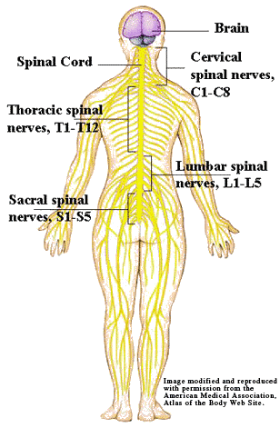
Spinal Cord, Spinal Nerves, & Cranial Nerves
By: Nikki Onwuanaibe & Maddie Lierman

Slide 2
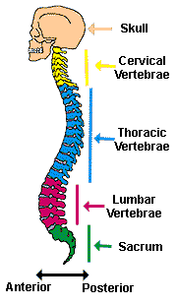
Spinal Cord (9.12 pg.221)
The spinal cord is a nerve column that extends from the brain into the vertebral canal
Structure
The spinal cord is composed of thirty-one segments, each of which gives rise to a pair of spinal nerves
The spinal cord has a cervical enlargement and a lumbar enlargement
It has a central gray matter within white matter
White matter consists of bundles of myelinated axons
Function
The spinal cord provides a two-way communication system between the brain and other body parts
Ascending tracts carry sensory impulses to the brain. Descending tracts carry motor impulses to muscles and glands

Slide 3
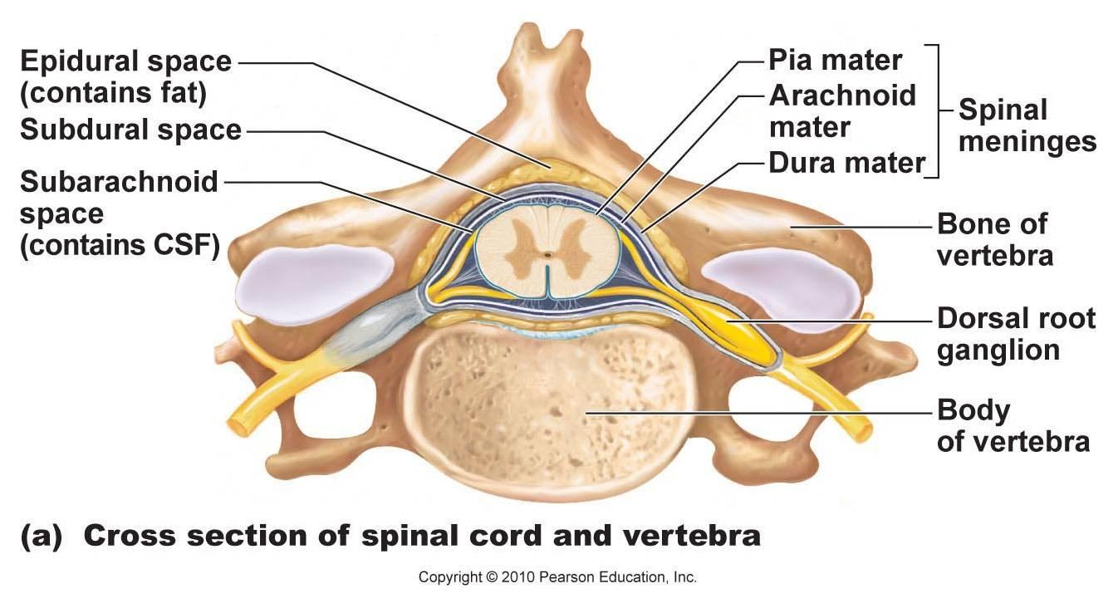
Spinal Cord (continued)

Slide 4
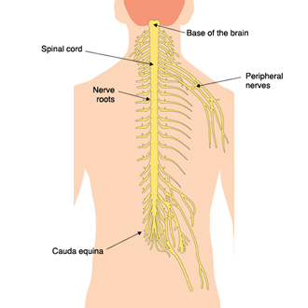
Spinal Nerves (9.14 pg. 233)
Thirty-one pairs originate in spinal cord
Mixed nerves provide a two-way communication system between the spinal cord and parts of the upper and lower limbs, neck, and trunk
Grouped according to the levels from which they arise, and they are numbered in sequence
Each one emerges by a dorsal and a ventral root
Each one divides into several branches just beyond its foramen
Most combine to form plexuses in which nerve fibers are sorted and recombined so that those fibers associated with a particular part reach it together

Slide 5
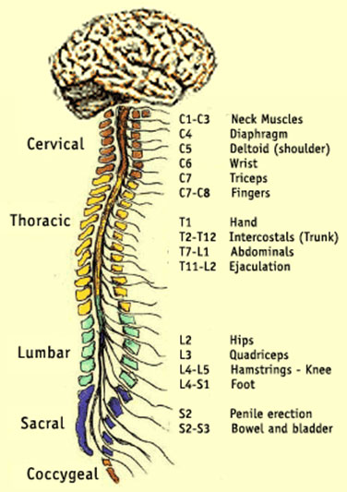
Spinal Nerves (continued)

Slide 6
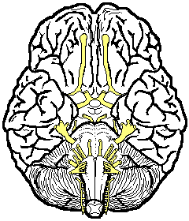
Cranial Nerves (9.14 pg. 233)
Twelve pairs connect the brain to parts in the head, neck, and trunk
Most are mixed, but some are purely sensory, and others are primarily motor
Name indicates primary functions or the general distributions of their fibers
Some are somatic and others are autonomic

Slide 7
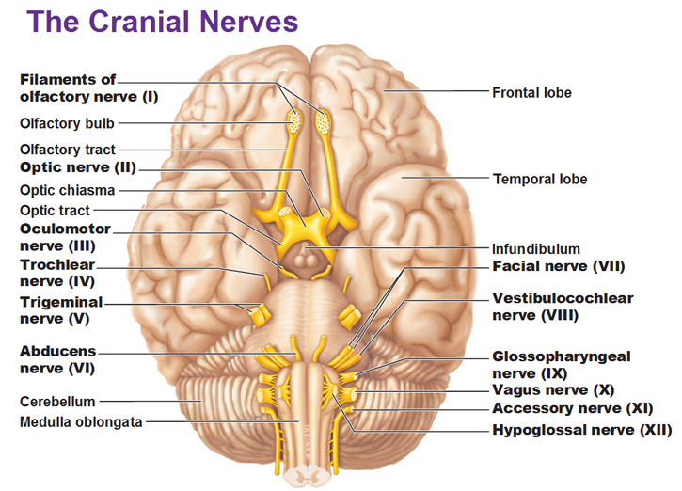
Cranial Nerves (continued)

